Slide 1

Gesture Detection based on EMG Signals using ML techniques
SUBMITTED BY-
Gurarpit Kaur- 2016UIC3129
Ayush Grover - 2016UIC3145
Sanya Devgon - 2016UIC3146
Surbhi Garg - 2016UIC3148

Slide 2
Research objective
The Emg signals can be used as input information to control robotic systems.Robot arms are versatile tools found in a wide range of applications. While the user moves his arm, (EMG) activity is recorded from selected muscles, using surface EMG electrodes. By a decoding procedure the muscular activity is transformed to kinematic variables that are used to control the robot arm. EMG signals, which are the electrical manifestations of the activity of muscles provides an important access to the human neuromuscular system. It has been used generate control commands for prosthetic devices and human-assisting manipulators. Up to the present, a number of EMG-based human interfaces have been proposed as a means for elderly people and the disabled to control powered prosthetic limbs, wheelchairs, teleoperated robots, and so on. The core part of these human–robot interfaces is a pattern classification process, where motions or intentions of motions are classified according to features extracted from EMG signals. Commands for device control are then generated from the classified motions
Hence,through this project we tend to investigate and compare the performance of two feature set extracted from publicly accessible to determine who’s classification accuracy is higher.EMG dataset, one in which features are extracted and the second in which the same features are extracted after applying windowing. Feature scaling and dimensionality reduction is used to remove redundancies. For classification three classifiers are used i.e. K nearest neighbour(KNN),Random forest (RF)and Decision tree(DT)(CART algorithm used).Performance of both the feature sets evaluated using these classifiers and the results are compared.

Slide 3
Abstract
Our work aims to develop a model for detection of hand gestures using EMG signals, with a vision to control prosthetic components and help give a voice to people with communication disabilities.The problem of hand movement identification is cast as a typical supervised pattern recognition problem. The raw EMG signals are used to extract features in time domain and frequency domain. In order to enhance the performance of classifiers another dataset with windowing method applied on it was also created, from which the same features were extracted. The extracted features were then scaled using Min-Max scaling method. Machine learning algorithms were applied, including Random Forest, K-Nearest Neighbours and Decision tree for classification. The results demonstrate KNN when used with the feature set with windowing, as the best classifier, demonstrating an accuracy an of 98%. Also,the results show that the overall feature set with windowing performs better than the one without.

Slide 4
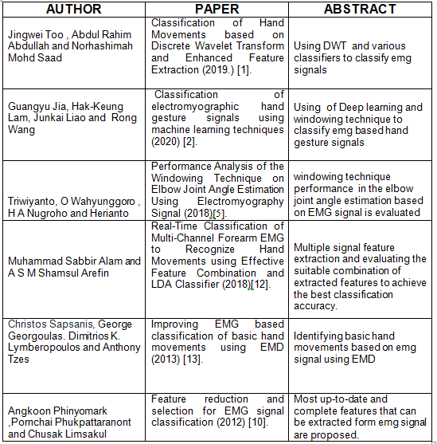
Literature survey
These are the following papers which we have used understanding and deriving our model, optimizing our model, and generating our final results.

Slide 5
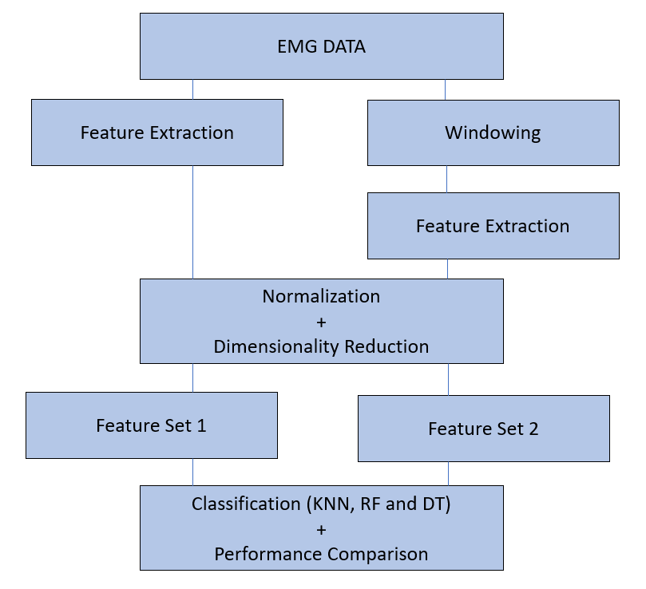
Methodology

Slide 6
Dataset Details
The experiments consisted of freely and repeatedly grasping different items to conduct the hand movements. The EMG data is acquired from the sEMG for Basic Hand Movements Data Set via UCI Machine Learning Repository. For the data collection six healthy subjects (2 males and 4 females) of the same age approximately (20 to 22-year-old) were asked to repeat the following six movements :
Spherical: For holding spherical tools.
Tip: For holding small tool.
Palmar: For grasping with palm facing the object.
Lateral: For holding thin, flat objects.
Cylindrical: For holding cylindrical tools.
Hook: For supporting a heavy load.
For each movement the subject was asked to perform it for 6 seconds. The data were collected at a sampling rate of 500 Hz.Data is signals in time-domain.
Notes:
The signals were band-pass filtered using a Butterworth Band Pass filter with low and high cutoff 15 Hz and 500 Hz respectively and a notch filter at 50Hz to eliminate line interference artifacts.

Slide 7
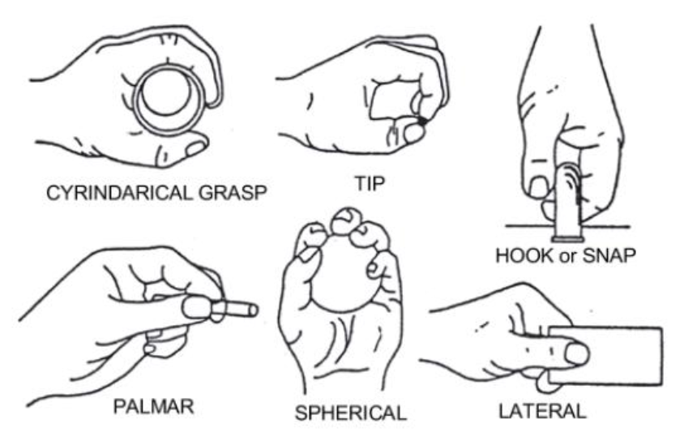

Dataset Details Cotd.
Figure: Various movements for which data collected
Table : Dataset description

Slide 8

Windowing Technique
Windowing technique is an important preprocessing technique that can help increase performance of classifiers. This method is divided into adjacent and overlap windowing[5]. In overlap window method part of following window is overlapped with previous window. Overlap Windowing was used to observe the performance of elbow joint angle estimation with EMG signal[5].Overlap windowing along with feature extraction ,feature reduction etc. for real time and fast classification of EMG signals[12]
The windowing technique is applied for the following reasons:
The Technique Increases the Number of Training Samples: The total number of samples is 900 which is insufficient for some classifiers. The number of training samples increases by using this method to 171900
By increasing the sample number classification Accuracy Enhances
The window size is related to EMG data length to number of training samples as:
The window size considered in our work is 300ms (150 samples) and window separation to be 30 ms (15 samples). Hence windowing increases the number of samples by a factor of 191 ( from 900 to 171900).

Slide 9
Feature Extraction
The three types of possible features are Time domain, Frequency domain, and the Time-Frequency domain[1],[10]. Total of 18 Time Domain Features and 7 Frequency Domain features have been considered :-
Time Domain Features | Frequency Domain Features
Integrated EMG (IEMG), Mean absolute value (MAV), Simple square integral (SSI), Zero Crossing (ZC), Wilson Amplitude (WA), Variance of EMG (VAR), Root Mean Square (RMS), Waveform length (WL), Amplitude Absolute Change (AAC), Slope Sign Change (SSC), Difference absolute standard deviation (DASDV), Log Detector (LD), Enhanced Mean Absolute Value ( EMAV), Enhanced Wavelength (EW), Modified Mean Absolute Value (MMAV), Modified Mean Absolute Value 2 (MMAV2), Maximum Fractal Length (MFL) | Total Power (TTP), Mean Power (MNP), Frequency Ratio (FR), Mean Frequency (MNF), Median Frequency (MDF), Modified Median Frequency (MMFD),Modified Mean Frequency (MMNF)
Notes:
It is the transformation of the raw signal data into a relevant data structure by removing noise, and highlighting the important data.
There are three main categories of features important for the operation of an EMG based control system. They are :
Time domain features are computed based upon the input signals amplitude. The resultant values give a measure of the waveform amplitude, frequency, and duration with some limitations.

Slide 10

Feature Scaling
A technique to standardize the independent features present in the data in a fixed range. It is performed during the data pre-processing to handle highly varying magnitudes or values or units. If feature scaling is not done, then a machine learning algorithm tends to weigh greater values, higher and consider smaller values as the lower values, regardless of the unit of the values. We have used Min-Max feature scaling to scale our dataset.
Min-Max Feature Scaling
Min-max feature scaling is the simplest method and consists in rescaling the range of features to scale the range in [0, 1] . Selecting the target range depends on the nature of the data. The general formula for a min-max of [0, 1] is given as:
Notes:
Most of the time, the dataset will contain features highly varying in magnitudes, units and range. But since, most of the machine learning algorithms use Euclidean distance between two data points (eg. KNN) in their computations, this is a problem.To suppress this effect, we need to bring all features to the same level of magnitudes. This can be achieved by scaling.For our project we have considered Min-Max Normalization.

Slide 11
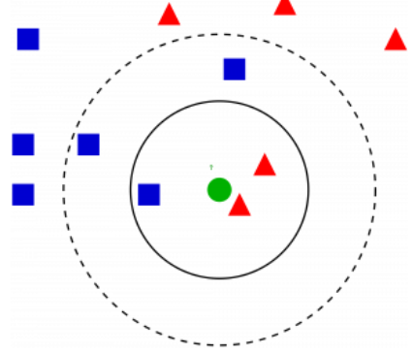

Classification
We have worked on different machine learning models to obtain which model gives the the most optimum prediction results. Some of the common machine learning models used in preparing this project are KNN( K-nearest neighbours) , Decision trees and Random forest. KNN (K -nearest neighbour) has given the best results out of the other two.
The foundational principle of the KNN algorithm is that similar data points lie close together. This assumption is based on the basic concept of calculation of distances between two data points. We have used Euclidean distances for obtaining our model results. The Euclidean distance metric can be given as follows:

Slide 12
Hyperparameters
The following table holds the information about the various hyperparameters we set for each classifier.
K-Nearest Neighbors | Random Forest | Decision Tree
N_Neighbours = 1 | Max_Depth = 50 | Max_Depth* = None
P = 2 | Criterion = ‘gini’ | Criterion = ‘gini’
Metric = “minkowski” | Bootstrap = True | Bootstrap = ‘best’
* Max_Depth = None means that means that the nodes are expanded until all leaves are pure or until all leaves contain less than min_samples_split samples (which is set to 2)

Slide 13





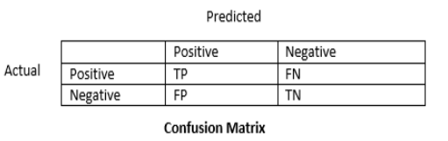
Model Evaluation Parameters
Parameters based on which we have measured the performance of the various classifiers are as follows -
Accuracy (Confusion Matrix) | Specificity | Precision | Recall | F1 Score
Figure: Sample Confusion Matrix

Slide 14
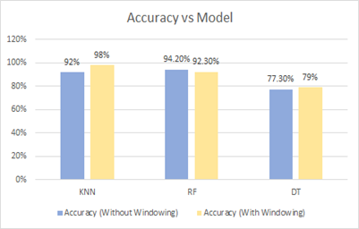
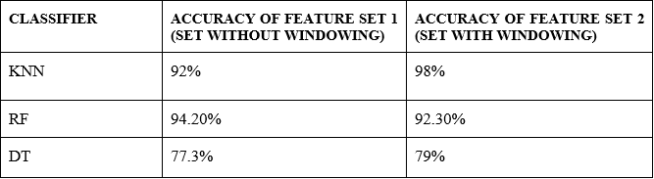
Result & Discussion
The Accuracy comparison across different classifiers is a very important aspect to deduce model performance and the overall most suitable classifier for the particular problem. The following figures and illustrate this aspect. Also, the two feature sets are also considered while plotting the graph.

Slide 15
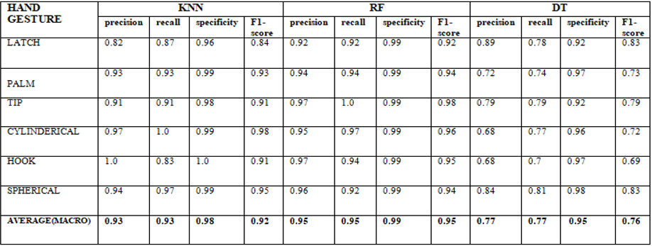
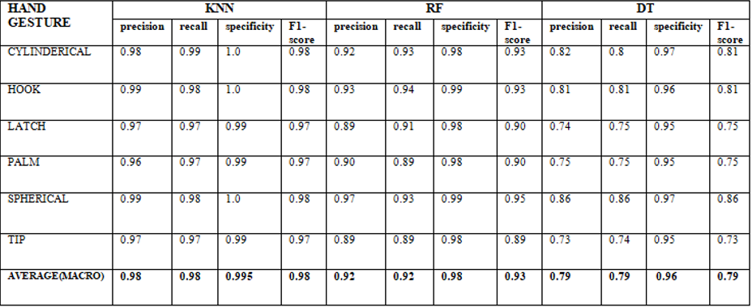
Result & Discussion Cotd.
Accuracy is an important factor to deduce a model’s performance, but for a more holistic approach we have considered other performance metrics as well. The following two tables display these parameters for both the type of feature sets.
Performance parameters for feature set without windowing
Performance parameters for feature set with windowing

Slide 16
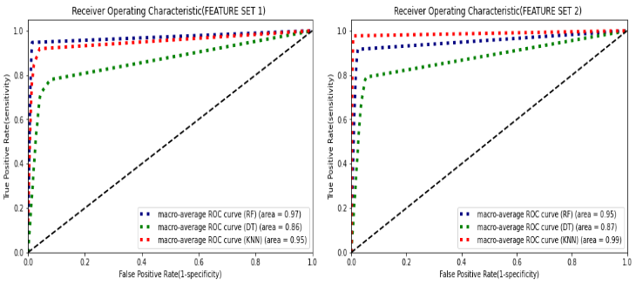
Result & Discussion Cotd.
As the final aspect for our result we considered the are under the ROC (Receiver Operating Curve). The comparison is made on the basis of the closeness of area under the curve to the value 1.
The following figure displays the values of AUC for different classifiers and also reiterates the results we got with other parameter consideration. Feature Set 1 includes the set without windowing whereas Feature set 2 refers to the set with the windowing method applied in the figure.

Slide 17
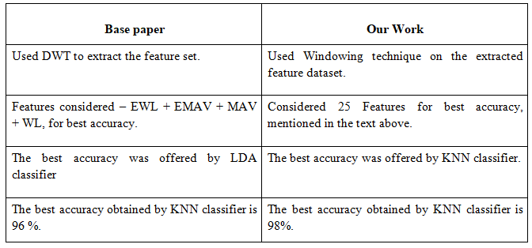
Benchmarking
The following is the comparison of our work with the past literature available on the same dataset with discussions along the same lines of gesture detection.
Comparison with [1]

Slide 18


Why KNN?
KNN can be used for both classification and regression predictive problems. However, it is more widely used in classification problems in the industry. To evaluate any technique we generally look at 3 important aspects:
1. Ease to interpret output
2. Calculation time
3. Predictive Power
KNN algorithm fairs across all parameters of considerations. It is commonly used for its easy of interpretation and low calculation time.

Slide 19
Conclusion
In our work, different machine learning techniques have been used to detect six hand gesture movements and have been compared on standard performance metrics - accuracy, F1 scores and the area under the receiver operating characteristics curve. Windowing as a processing tool was used on the feature set to explore the possibility of improved parameter performance.
Random Forest Classification, Decision Tree algorithm, K – Nearest Neighbours have been carried out on the dataset from EMG signals corresponding to six hand movements. Our results which remained consistent across parameter considerations, showed an improvement in the overall performance of KNN when applied to feature set 2 (with windowing) and that it outperforms every other classifier considered (98% accuracy). Apart from this, we observed that the feature set 2 (dataset with windowing) showed an overall better performance than feature set 1 (dataset without windowing).
KNN classification with windowing applied feature sets has good absolute performance to a certain degree there should be further exploration to understand its potential.

Slide 20
Written a research paper based on our project and have communicated for approval to our project mentor.

Slide 21
References
[1] J. Too, A. Rahim, and N. Mohd, “Classification of Hand Movements based on Discrete Wavelet Transform and Enhanced Feature Extraction,” International Journal of Advanced Computer Science and Applications, vol. 10, no. 6, 2019.
[2] G. Jia, H.-K. Lam, J. Liao, and R. Wang, “Classification of electromyographic hand gesture signals using machine learning techniques,” Neurocomputing, vol. 401, pp. 236–248, Aug. 2020.
[3] “UCI Machine Learning Repository.” Website: https://archive.ics.uci.edu/ml/index.php.
[4] A. Phinyomark, P. Phukpattaranont, and C. Limsakul, “Feature reduction and selection for EMG signal classification,” Expert Systems with Applications, vol. 39, no. 8, pp. 7420–7431, Jun. 2012.
[5] Triwiyanto, O. Wahyunggoro, H. A. Nugroho, and Herianto, “Performance Analysis of the Windowing Technique on Elbow Joint Angle Estimation Using Electromyography Signal,” Journal of Physics: Conference Series, vol. 1108, p. 012004, Nov. 2018.
[6] I. T. Jolliffe and J. Cadima, “Principal component analysis: a review and recent developments,” Philosophical Transactions of the Royal Society A: Mathematical, Physical and Engineering Sciences, vol. 374, no. 2065, p. 20150202, Apr. 2016.

Slide 22
References
[7] E. Gokgoz and A. Subasi, “Comparison of decision tree algorithms for EMG signal classification using DWT,” Biomedical Signal Processing and Control, vol. 18, pp. 138–144, Apr. 2015.
[8] C. Sapsanis, G. Georgoulas, and A. Tzes, “EMG based classification of basic hand movements based on time-frequency features,” 21st Mediterranean Conference on Control and Automation, Jun. 2013.
[9] J. Too, A. Abdullah, N. Mohd Saad, and W. Tee, “EMG Feature Selection and Classification Using a Pbest-Guide Binary Particle Swarm Optimization,” Computation, vol. 7, no. 1, p. 12, Feb. 2019.
[10] Phinyomark, A., Limsakul, C. and Phukpattaranont, P., 2009. A novel feature extraction for robust EMG pattern recognition. arXiv preprint arXiv:0912.3973.
[11] A. A. Abdullah, A. Subasi, and S. M. Qaisar, “Surface EMG Signal Classification by Using WPD and Ensemble Tree Classifiers,” CMBEBIH 2017, pp. 475–481, 2017.

Slide 23
References
[12] M. S. Alam and A. S. Arefin, “Real-Time Classification of Multi-Channel Forearm EMG to Recognize Hand Movements using Effective Feature Combination and LDA Classifier,” Bangladesh Journal of Medical Physics, vol. 10, no. 1, pp. 25–39, Dec. 2018.
[13]C. Sapsanis, G. Georgoulas, A. Tzes, and D. Lymberopoulos, “Improving EMG based classification of basic hand movements using EMD,” 2013 35th Annual International Conference of the IEEE Engineering in Medicine and Biology Society (EMBC), Jul. 2013.

